Slide 1
A Historical Reference List
Billy Waters: Songs from the Shadows
Highlighted in yellow is text from primary sources that is directly quoted or adapted into the dialogue of the graphic novel. Other more indirect visual cues or contextual information that guided the story are also included.

Slide 2
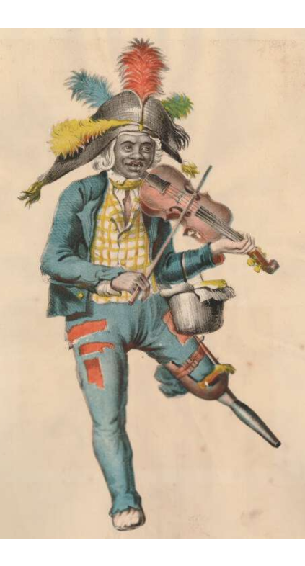
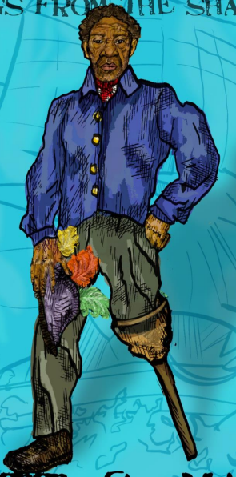
Titlepage
Left: “Portrait of Billy Waters, the well known one-legged black street fiddler” from The British Museum, hand-coloured print, c.1830 after original by Thomas L. Busby in Costume of the Lower Orders of London (1819)
https://www.britishmuseum.org/collection/object/P_2006-0929-46

Slide 3
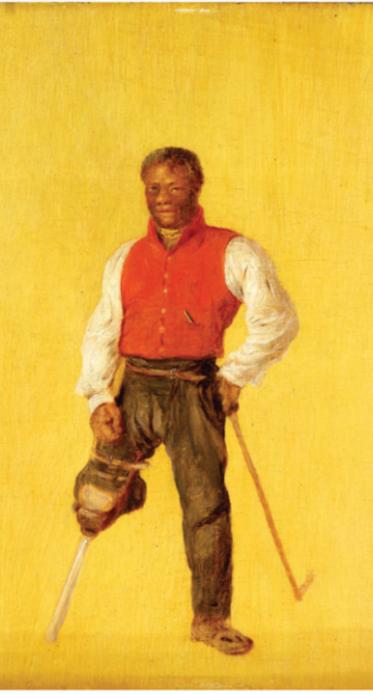
Titlepage
Left: “Painting of Billy Waters by David Wilkie” from Royal Museums Greenwich, painting, c.1815
“While the attribution to Sir David Wilkie is not certain, it is entirely possible that Waters was painted by him most likely in London.”
https://www.rmg.co.uk/collections/objects/rmgc-object-254220

Slide 4
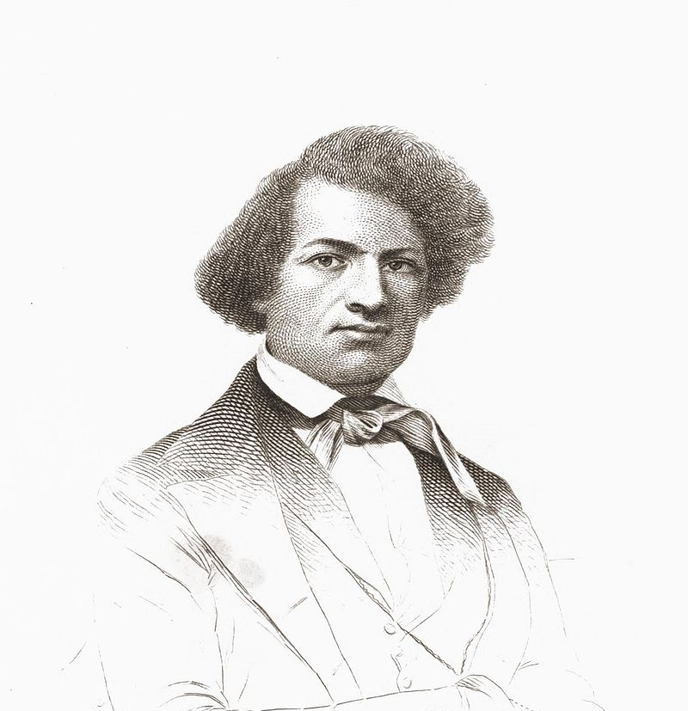
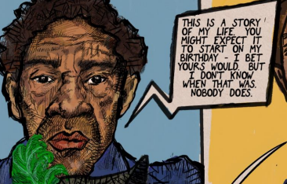
Page 1
Frederick Douglass, Narrative of the Life of Frederick Douglass, an American Slave. Written by Himself (Boston, 1845), p.1.
https://docsouth.unc.edu/neh/douglass/douglass.html
“I have no accurate knowledge of my age, never having seen any authentic record containing it. By far the larger part of the slaves know as little of their ages as horses know of theirs, and it is the wish of most masters within my knowledge to keep their slaves thus ignorant. I do not remember to have ever met a slave who could tell of his birthday.”

Slide 5
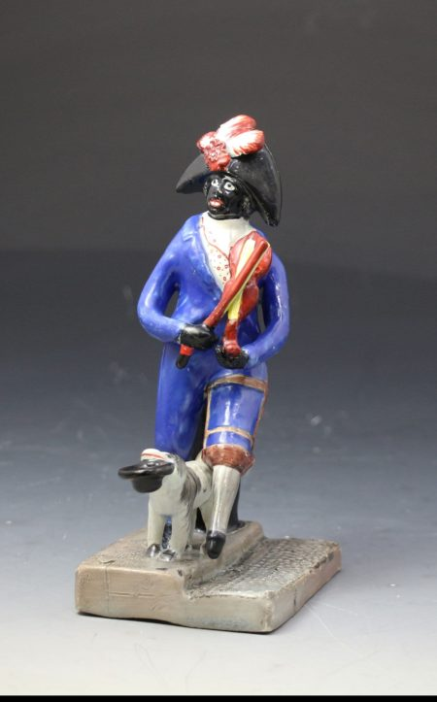
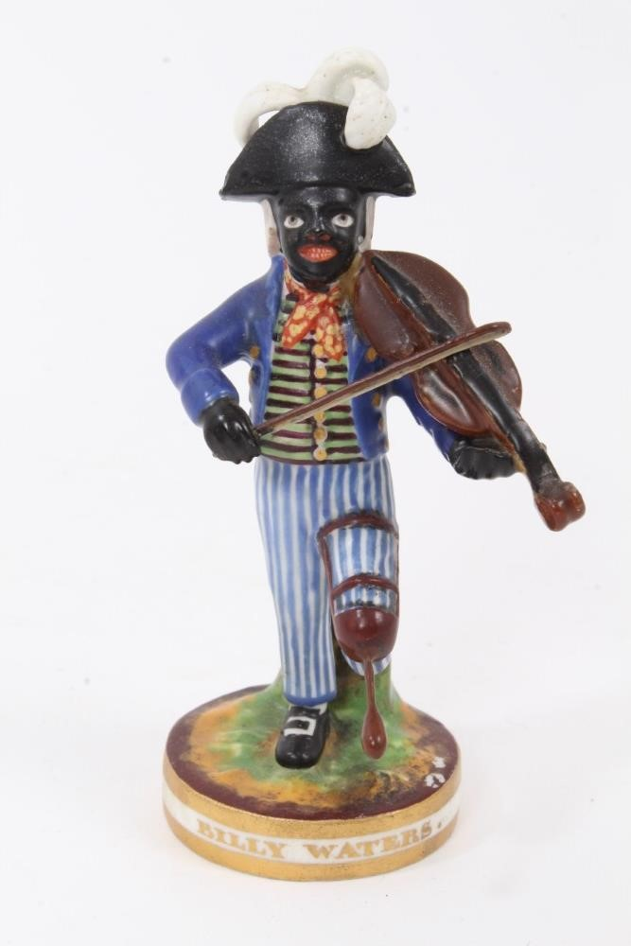
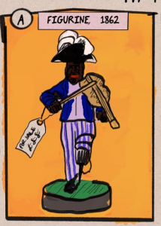
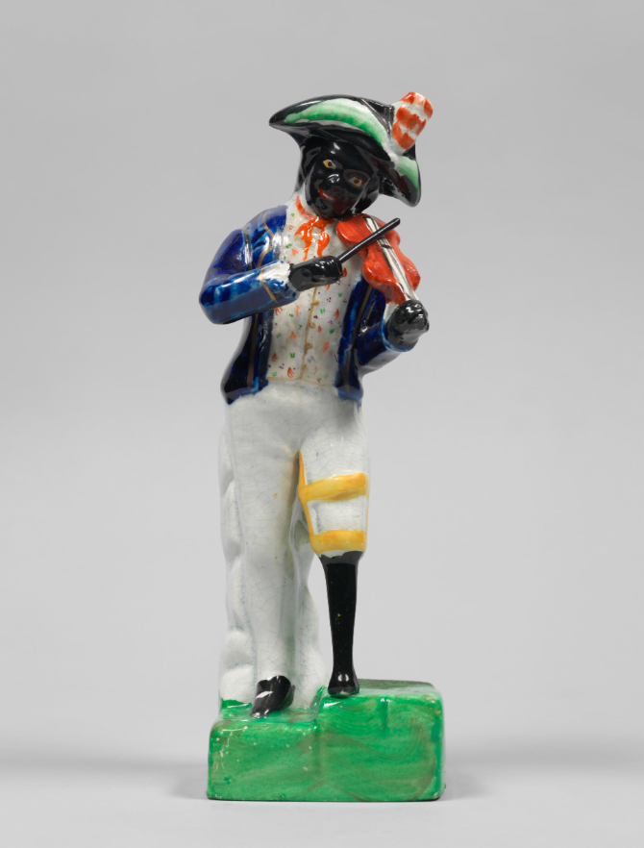
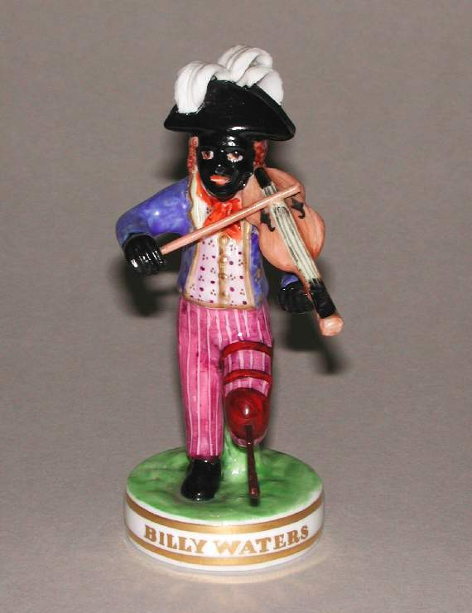
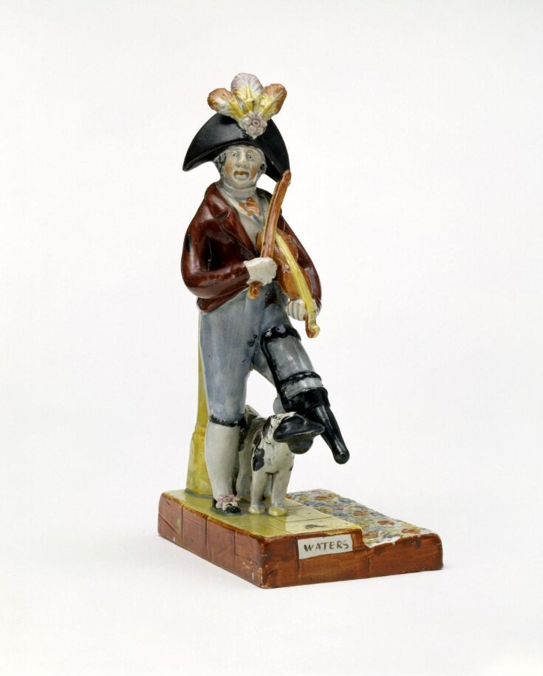
Page 1
Billy Waters Figurine, Staffordshire, National Portrait Gallery (c.1840) – bottom left
  https://ageofrevolution.org/200-object/billy-waters-figurine/
Billy Waters Figurine, Staffordshire, John Howard Antique English Pottery (c.1820) – top left
  https://www.antiquepottery.co.uk/product/antique-staffordshire-pottery-pair-of-figures-douglas-and-billy-waters/
Billy Waters Figurine, Derby, Fitzwilliam Museum (c.1862) – bottom middle
  https://data.fitzmuseum.cam.ac.uk/id/object/71119
Billy Waters Figurine, Staffordshire, Victoria & Albert Museum (c.1820-30) – bottom right
  https://collections.vam.ac.uk/item/O70193/billy-waters-figure-unknown/
Billy Waters Figurine, Derby (c.1820), sold for £140 in August 2022, Reeman Dansie Auctioneers – top middle
  https://www.reemandansie.com/auction/lot/185-a-derby-figure-of--billy-waters-circa-1820-and-a-derby-king-street-works-figure-of-african-sall-circa-1880/?lot=126579&sd=1

Slide 6
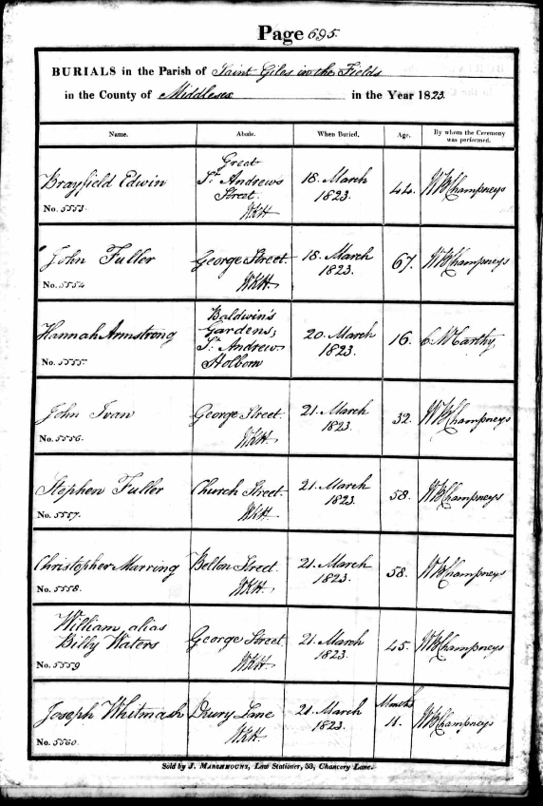
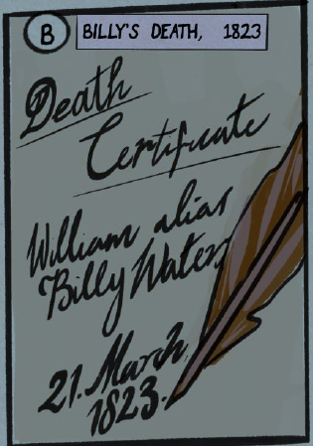
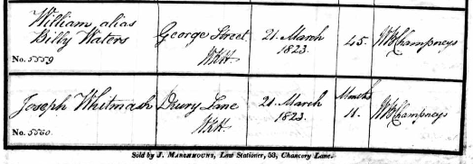
Page 1
Parish burial register, St. Giles in the Fields (Middlesex, London), 21 March 1823
  London Metropolitan Archives, London, England, Church of England Deaths and Burials, p.695 no.5559 from “Bishop’s Transcripts” (copies of the original registers) now in online database (1813-2003) hosted by www.ancestry.com.
Notes:
Before 1837 and civil registration, key events in a person’s life were typically recorded by the Church rather than the State – usually through parish records (christenings, marriages, and burials). Beginning in 1598, clergy were required to send copies of their parish registers to the bishop of their diocese.

Slide 7
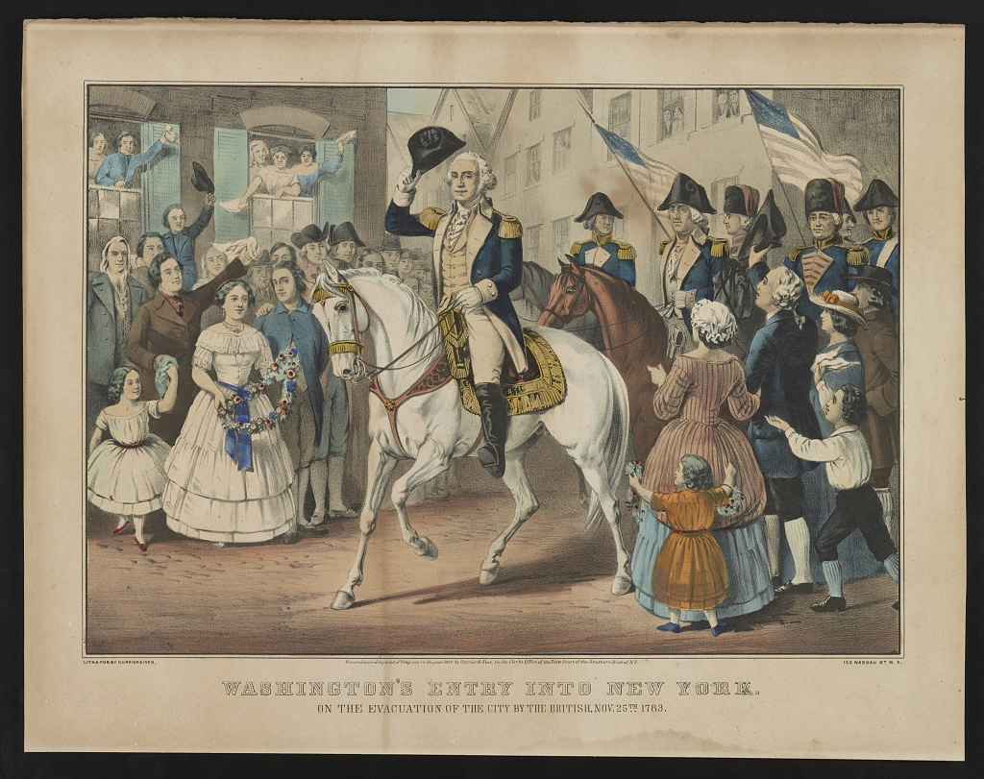

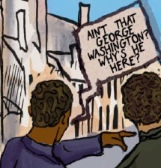
Page 2
“Account of a Conference between Washington and Sir Guy Carleton, 6 May 1783,” New York, from The Papers of George Washington
https://founders.archives.gov/documents/Washington/99-01-02-11217
George Washington “had requested the Interview…[for] obtaining the delivery of all Negroes and other Property of the Inhabitants of these States in the Possession of the [British] Forces.”
Image: “Washington’s entry into New York” [created c.1857], Library of Congress, https://www.loc.gov/resource/pga.05068/?st=image

Slide 8
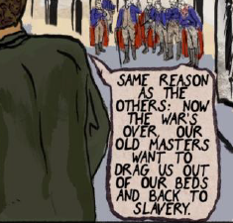
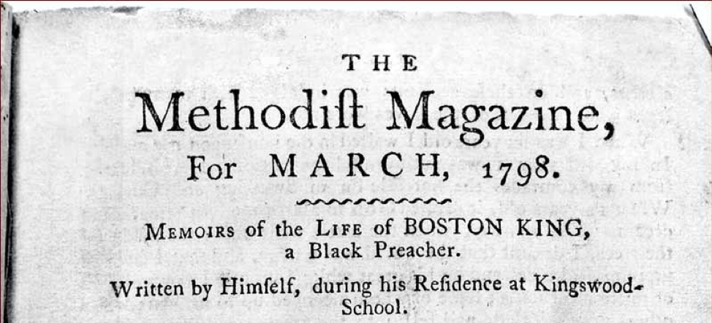
Page 2
“Memoirs of the Life of Boston King, a Black Preacher,” The Methodist Magazine (March 1798)
https://blackloyalist.com/cdc/documents/diaries/king-memoirs.htm
“This dreadful rumour filled us all with inexpressible anguish and terror, especially when we saw our old masters coming from Virginia, North Carolina, and other parts, and seizing upon their slaves in the streets of New York, or even dragging them out of their beds. Many of the slaves had very cruel masters, so that the thoughts of returning home with them embittered life to us. For some days we lost our appetite for food, and sleep departed from our eyes.”

Slide 9
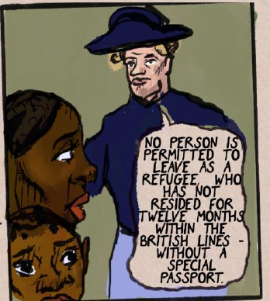
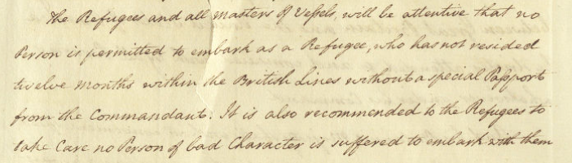
Page 2
“Orders” from Oliver DeLancey, Adjutant General, British Headquarters, New York (22 May 1783) in Guy Carleton Papers, The National Archives
https://archives.novascotia.ca/africanns/book-of-negroes/page/?ID=2
“The Refugees and all masters of vessels will be attentive that no person is permitted to embark as a Refugee, who has not resided twelve months within the British Lines without a special passport from the Commandant. It is also recommended to the Refugees to take care no person of bad character is suffered to embark with them.”

Slide 10
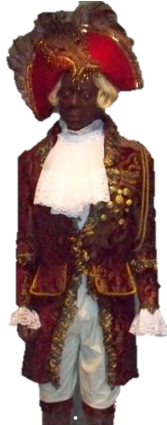
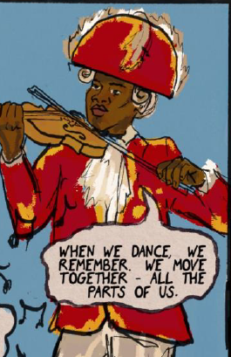
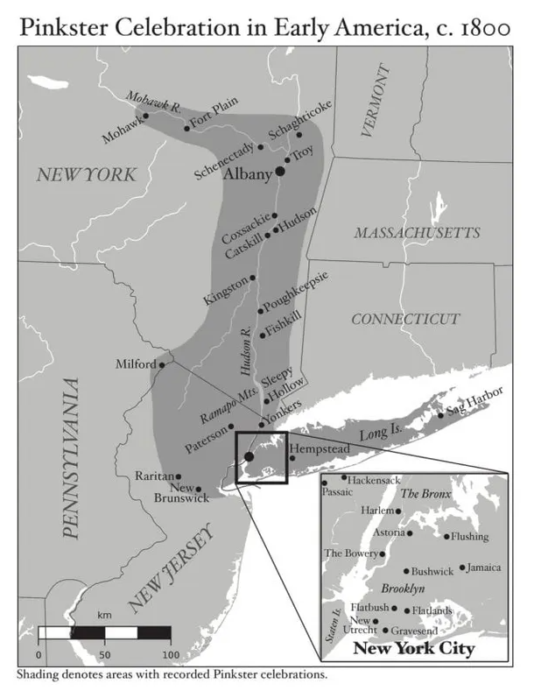
Page 2
John J. Williams, formerly enslaved Black from Albany, quoted in George R. Howell, Bicentennial History of Albany (2 vols., 1886), vol.2, p.725: https://books.google.co.uk/books?id=nWkJAQAAIAAJ.
“Pinkster Day was … like our Christmas day. … Many of the old Colored people … were born in Africa and would dance their wild dances and sing in their native language.”
Pinkster holidays took place during the late spring, a tradition brought to New York by its early Dutch migrants. By c.1800 it had evolved into a rare opportunity for enslaved people to enjoy privileges denied them under slavery – travel, gathering, self-expression, celebrating alongside free blacks.
  https://hudsonvalley.org/article/what-is-pinkster/
Historians have argued that the African-American Pinkster festival had origins in West Central Africa as well as the Dutch Republic. Music featured prominently, as did costume and dance and the choice of a festival ‘King’. It was similar to other Black community cultural events such as Junkannoo (at Christmas time, often in the West Indies).
Photo of recreation of ‘Pinkster King’ in Smithsonian Anacostia Community Museum, Washington D.C., from exhibition Jubilee: African American Celebration (2009)
Notes:
Map by Flynn Walsh from Jeroen Dewulf, The Pinkster King and the King of Kongo: The Forgotten History of America’s Dutch-Owned Slaves (Jackson, Miss.: University Press of Mississippi, 2017)

Slide 11
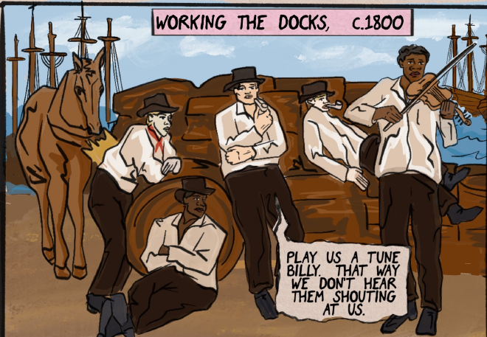
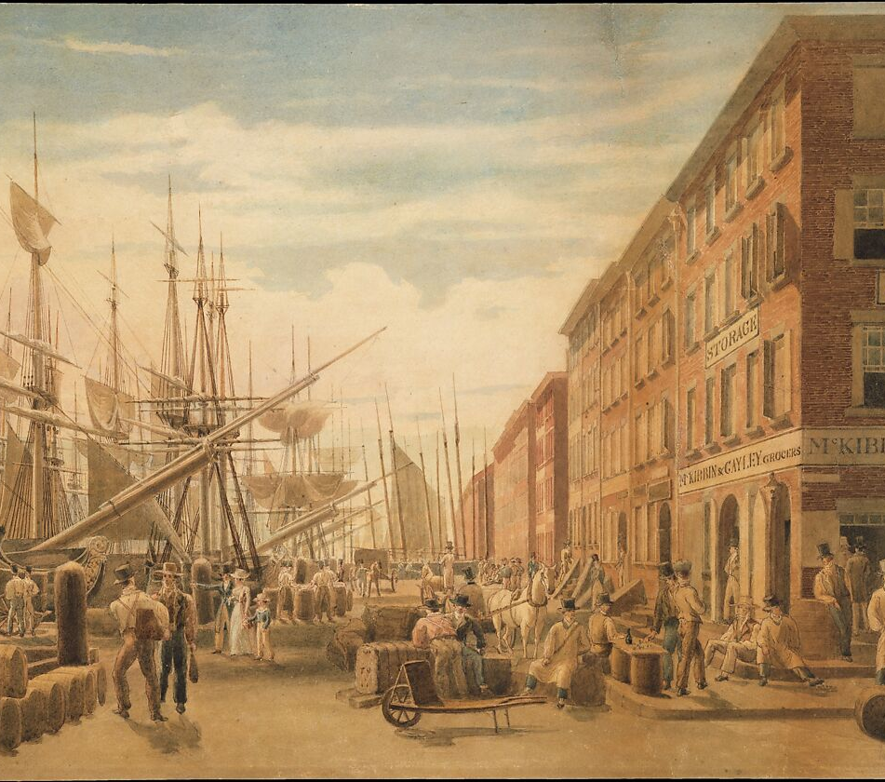
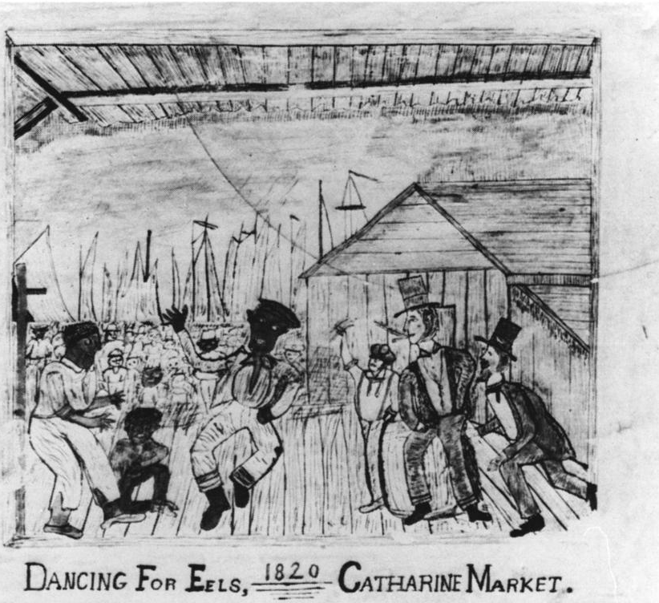
Page 3
Suggested location is Schermerhorn Row, which acted as a New York hub for transshipment of American cotton, built by merchant Peter Schermerhorn who owned two enslaved people, Nancy and Boston Crummell (an oysterman he later freed).
“Dancing For Eels 1820 Catharine Market” (anon. charcoal sketch) New York, a wharf on Lower East Side of Manhattan.
  Includes Black figures dancing Afro-Caribbean Juba (stomping and slapping), and white Irish-Americans playing the rhythm bones (percussive clackers made of bone or wood)
Painting of “View of South Street, from Maiden Lane, New York City” by William James Bennett, c.1827: https://www.metmuseum.org/collections/search-the-collections/10141
“Ship owners, ship captains and maritime business operators when hiring workers were often more concerned with muscle and maritime skills than skin color or enslaved status.” – Charles R. Foy, “Blacks on the New York Waterfront During the American Revolution (2016): https://redhookwaterstories.org/exhibits/show/blacks-on-the-waterfront/blacks-waterfront-american-rev.

Slide 12
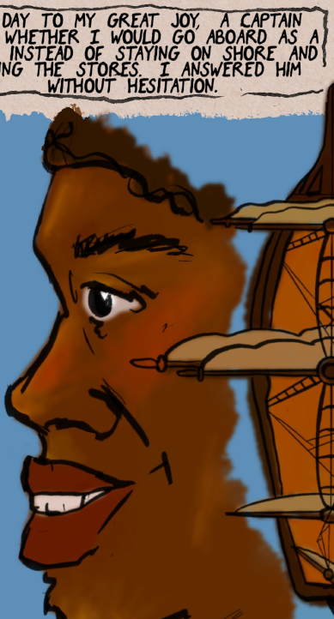
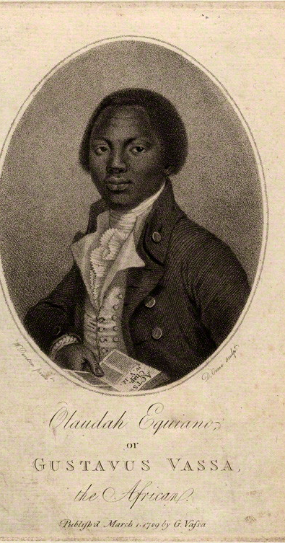
Page 3
Olaudah Equiano, The Interesting Narrative of the Life of Olaudah Equiano, or Gustavus Vassa, the African. Written by Himself (New York, 1791), pp.165-67.
https://quod.lib.umich.edu/e/evans/N18028.0001.001/
“One day to my great joy, told me the captain would not let him rest, and asked whether I would go aboard as a sailor, or stay on shore and mind the stores … I therefore, without hesitation, answered him, that I would go and be a sailor.”

Slide 13
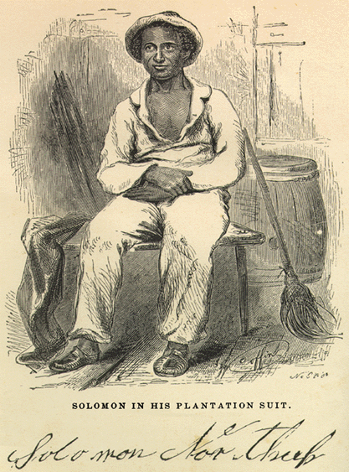
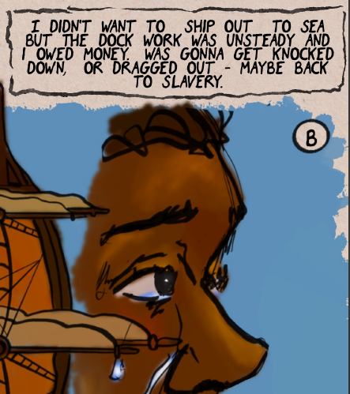
Page 3
Horace Lane, The Wandering Boy, Careless Sailor, and Result of Inconsideration: a True Narrative (1839) p.68.
  Lane (1789-1866) was a white lower-class sailor from New York, who struggled to find work, was impressed into service (three times by the British), and fell into poverty, alcoholism, crime, and imprisonment.
https://archive.org/details/wanderingboycare00lane
“Our sturdy crew soon raised a breeze among the grog-shops and dens of infamy … It was knock down, and drag out, everything in human shape.”
Solomon Northup, Twelve Years a Slave: Narrative of Solomon Northup, a Citizen of New-York, Kidnapped in Washington City in 1841 (1853), p.39.
https://docsouth.unc.edu/fpn/northup/northup.html
“It could not be that a free citizen of New-York, who had wronged no man, nor violated any law, should be dealt with thus inhumanly. The more I contemplated my situation, however, the more I became confirmed in my suspicions. It was a desolate thought, indeed. I felt there was no trust or mercy in unfeeling man; and commending myself to the God of the oppressed, bowed my head upon my fettered hands, and wept most bitterly.”
Notes:
He “shipped out to sea at an early age to escape an impoverished, unstable life on land.” – Myra C. Glenn, “Troubled Manhood in the Early Republic: The Life and Autobiography of Sailor Horace Lane” (2006): https://muse.jhu.edu/pub/56/article/194403.
“Lane's troubled life also offers another vantage point from which to view the middle-class culture that dominated American society during the first half of the nineteenth century. Studying men whose lives were marginal, even deviant, suggests how the dominant society defined acceptable codes of masculinity and how it regarded and treated men who violated these codes.” – Myra C. Glenn, “Troubled Manhood in the Early Republic: The Life and Autobiography of Sailor Horace Lane” in Journal of the Early Republic 26.1 (2006): 59-93. https://muse.jhu.edu/pub/56/article/194403

Slide 14
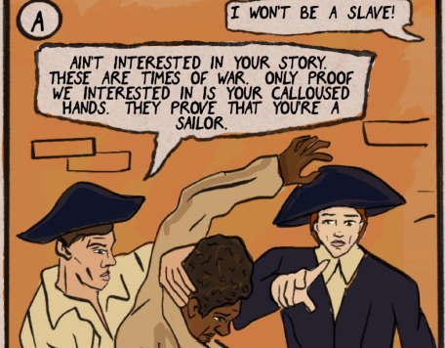
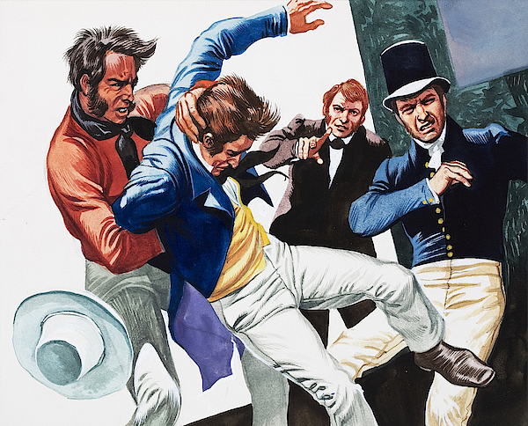
Page 4
Robert Hay, Landsman Hay – The Memories of Robert Hay (ed. M.D. Hay, 1958), pp.217-220.
  Hay (1789-1847), born in Paisley, Scotland, wrote his memoir of naval life in 1820, having first served in the Royal Navy aged 14 and later been press ganged and taken to the same ship as Billy Waters in the same month (October 1811). As commonplace, he was offered the chance to volunteer, which would have provided him a signing bonus, but he declined. Waters did not.
For this excerpt and his interview by the officer: http://www.eyewitnesstohistory.com/shanghaied.htm.
“In a moment I was in the hands of six or eight ruffians who I immediately dreaded and soon found to be a press gang … I was immediately carried into the presence of the Lieutenant of the gang, who questioned me as to my profession … my hands being examined and found hard with work, and perhaps a little discolored with tar … I was remanded … My doom was fixed and I was thrust down among five or six score of miserable beings, who like myself had been kidnapped, and immured in the confined and unwholesome dungeon of a press room … I had entered London possessed of Liberty and buoyed up with animating hope. Now, I was a slave.”
Image: painting by British comic strip artist Gerry Embleton, “Press Gang”
Notes:
Christopher P. Magra, Poseidon’s Curse: British Naval Impressment and Atlantic Origins of the American Revolution (CUP, 2016), Chapter 8, “Mariners and Liberty”.

Slide 15
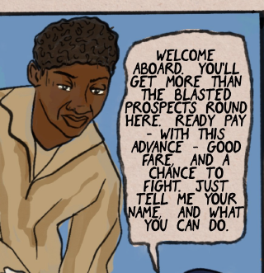
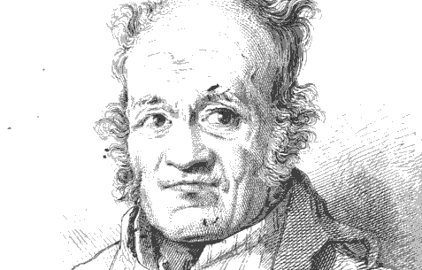
Page 4
John Nicol, The Life and Adventures of John Nicol, Mariner (Edinburgh, 1822), p.172.
  Nicol (1755-1825), born in Edinburgh, Scotland, recounted his memoir to Scottish bookbinder John Howell, who edited the memoirs of several impoverished Napoleonic veterans, giving them the royalties.
https://archive.org/details/cihm_41947/
“I therefore made up my mind to it [enlisting], and was as happy as a man in blasted prospects can be ... I was taken on board.”
Robert Hay [details on previous slide] citing his interviewing officer: “As to wages … the chance of prize money is quite an equivalent … enter the service cheerfully, you will then have a bounty, and be in a fair way for promotion.”
Notes:
Jeffrey Bolster, Black Jacks: African American Seamen in the Age of Sail (1998), p.216, notes “Black seamen took advantage of sailors’ anonymity to name themselves at will.”

Slide 16
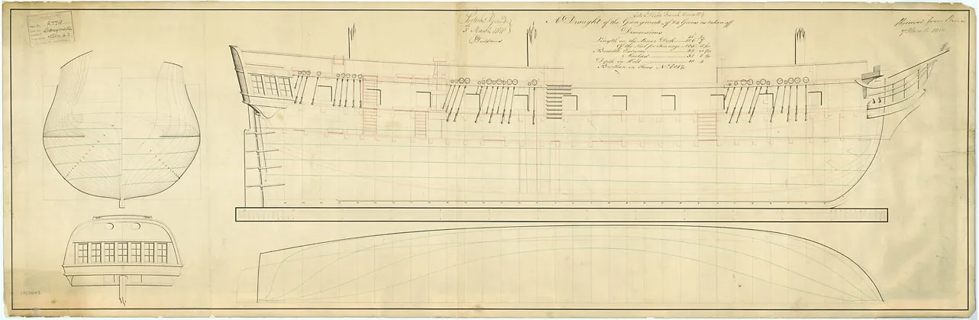
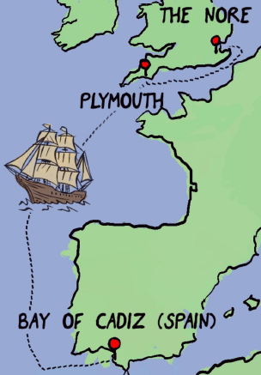
Page 4
Ship body plan (technical drawing) of HMS Ganymede, a corvette captured from the French (Hébé) en route to San Domingo in 1809. This plan drawn at Portsmouth by master shipwright Nicholas Diddams prior to refitting it as a 24-gun Sixth Rate.
https://www.rmg.co.uk/collections/objects/rmgc-object-83434
Billy Waters was first held on the guardship HMS Ceres on 5 October 1811, then transferred to HMS Namur on 23 November at the naval anchorage at The Nore (off Sheerness), and joined HMS Ganymede on 7 December for its cruise and convoy to Cadiz via Plymouth.

Slide 17
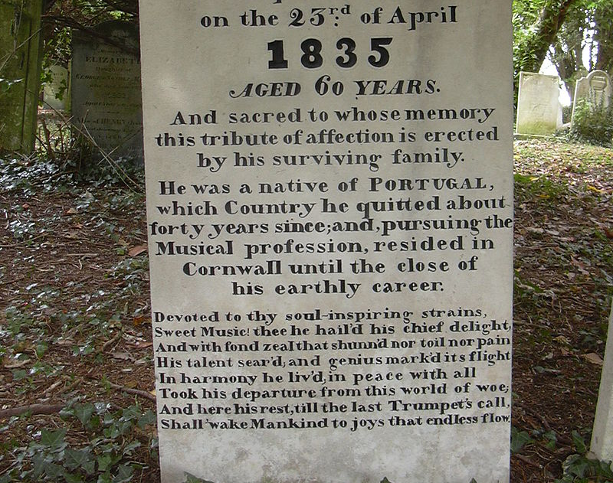
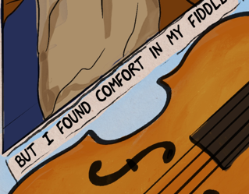
Page 5
Gravestone of Joseph Antonio Emidy, Kenwyn church yard, Truro, Cornwall
  Joseph Antonio Emidy (c.1775-1835) was a Black Guinean-born musician enslaved by Portuguese traders, freed, and then impressed into the Royal Navy for four years as a ship’s fiddler. He was discharged at Falmouth, Cornwall in 1799, married a local tradesman’s daughter, Mary Hutchins, and became a notable and celebrated composer and violinist, though no works survive.
https://en.wikipedia.org/wiki/Joseph_Antonio_Emidy
“Devoted to thy soul-inspiring strains, Sweet Music! Thee he hail’d his chief delight.”
Notes:
Richard McGrady, "Emidy, Joseph Antonio (c.1770–1835)", Oxford Dictionary of National Biography, Oxford University Press, 2004

Slide 18
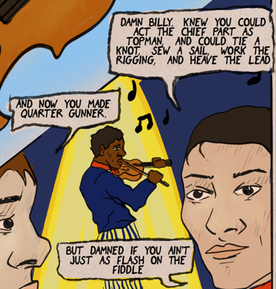
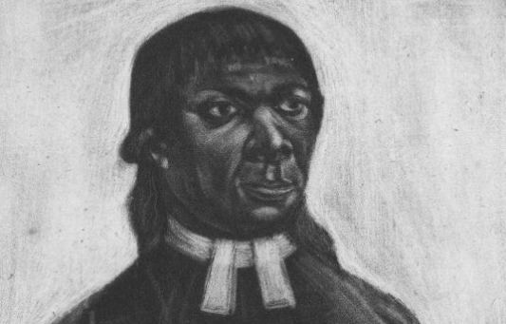
Page 5
Robert Wilson, “Robert Wilson’s Journal,” in Five Naval Journals, 1789-1817, ed. H.G. Thursfield, Navy Records Society (1951), pp.154-158.
  Robert Mercer Wilson was a pressed man and able seaman on the frigate HMS Unité from 1805-1809.
“the Topmen act the chief part / And boldly show the skilful seamen’s art.”
Edmund Miles, An Epitome, Historical and Statistical, Descriptive of the Royal Naval Service of England (1841)
https://books.google.co.uk/books?id=u3eWA3P--YAC
“ABLE SEAMAN … can hand, reef, and steer, use the palm and needle, fit rigging and sails, heave the lead, knows the points of the compass.”
John Marrant, A Narrative of the Lord’s Wonderful Dealings with John Marrant, a Black (1785), p.8.
  Marrant (1755-1791) was born free in New York City and moved to South Carolina. He was impressed into the Royal Navy during the American Revolution and served as a musician for more than six years. He was among the Black Loyalists evacuated from New York in 1783 and later becoming a Black preacher and missionary in Nova Scotia before settling in London from 1790, and is buried in Islington. Image: John Marrant, published by Daniel Boulter, 1795 (Fitzwilliam Museum)
https://archive.org/details/cihm_20674
“he put the violin into my hand, which pleased me much, and applying close, I learned very fast, not only to play, but to dance also.”
Notes:
Cf. Solomon Northup, Twelve Years a Slave, p.24: “my fiddle was notorious” or p.196: “I was indebted to my violin, my constant companion, the source of profit, and soother of my sorrows”, op. cit.
Nicholas Rogers, “Lower Deck Narratives and Sociability in the British Navy, 1750-1815” in Kevin Gilmartin, ed., Sociable Places: Locating Culture in Romantic-Period Britain (2017), chapter 10.

Slide 19
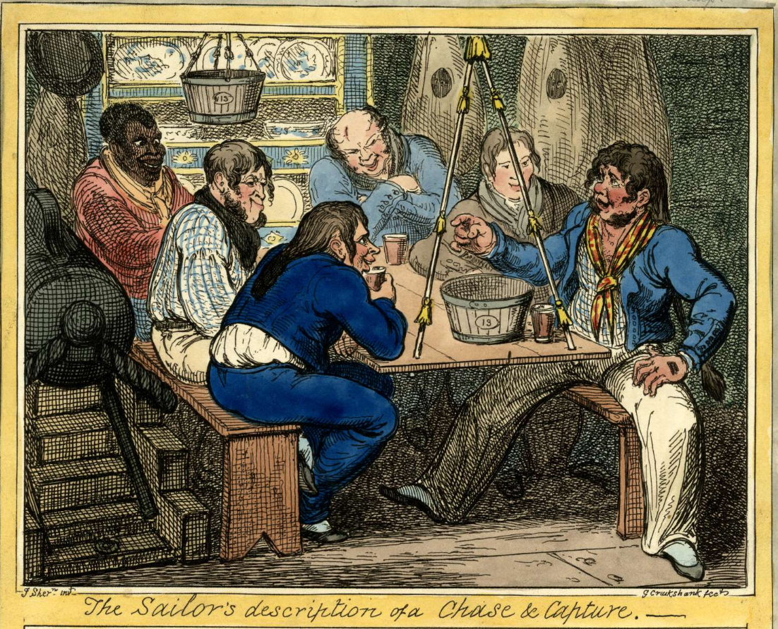
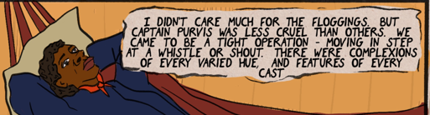
Page 6
The captain preceding Capt. John Brett Purvis on HMS Ganymede, Capt. Robert Preston, was charged with acts of “cruelty, tyranny and oppression” in a court martial in October 1812. Purvis went on to command ships protecting the British Empire in the Indian Ocean.
http://www.ageofnelson.org/MichaelPhillips/info.php?ref=0998
Charles Reece Pemberton, The History of Pel Verjuice, the Wanderer (1853), p.96.
  Pemberton (1790-1840) was born in Pontypool (Wales) and press ganged while at Liverpool in 1807, serving seven years including active service off Cadiz. Later a struggling actor and theatre manager, he wrote an autobiography in 1833.
https://books.google.co.uk/books?id=CBpeAAAAcAAJ
“I was now one of themselves … to come at a whistle and run at a blow.”
Image: “The Sailor’s Description of a Chase and Capture,” satirical print by George Cruikshank (London, 1822): https://www.britishmuseum.org/collection/object/P_1859-0316-170
Robert Hay, Landsman Hay – The Memories of Robert Hay, pp.43-4.
“To the eye were presented complexions of every varied hue, and features of every cast, from the jetty face, flat nose, thick lips and frizzled hair of the African, to the more slender frame and milder features of the Asiatic. The rosy complexion of the English Swain and the sallow features of the sun-burnt Portuguese.”

Slide 20

Page 6
Frederick Douglass, My Escape from Slavery (1881), recounting 1838, p.126.
https://xtf.lib.virginia.edu/xtf/view?docId=modern_english/uvaGenText/tei/DouEsca.xml
“My knowledge of ships and sailor's talk came much to my assistance, for I knew a ship from stem to stern, and from keelson to cross-trees, and could talk sailor like an ‘old salt’.”
Robert Hay, Landsman Hay – The Memories of Robert Hay, p.44.
“To the ear came a hubbub little short of Babel: Irish, Welsh, Dutch, Portuguese, Spanish, French, Swedish, Italian, together with every provincial dialect.”

Slide 21
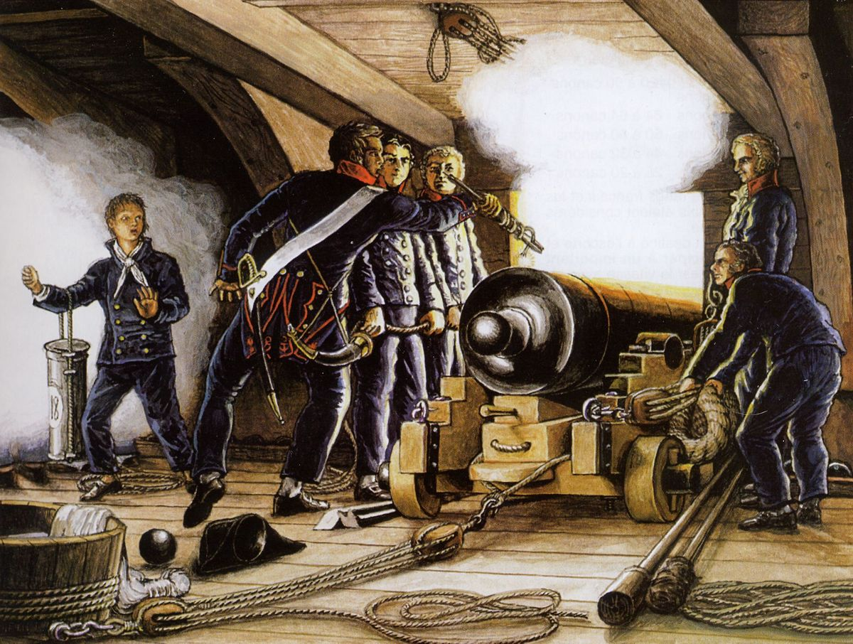
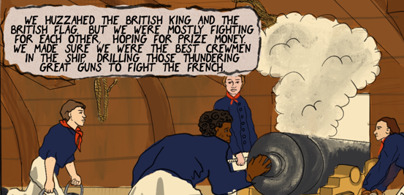
Page 6
Herman Melville, White-Jacket OR The World in a Man-Of-War (1892), recounting 1843, chapter 4.
  Melville (1819-1891) was an American novelist from New York, whose first career was as a sailor.
https://www.gutenberg.org/files/10712/10712-h/10712-h.htm
“We accounted ourselves the best seamen in the ship … we nourished that feeling of ‘esprit de corps’ … we loaned ourselves to each other with all the freedom in the world.”
Equiano, Interesting Narrative, pp.103-4.
“I was frequently stunned with the thundering of the great guns.”
“Not for nothing did seamen call each other ‘Brother Tar’ … the dangers of their work and their collective need for safety intensified their solidarity.” – Marcus Rediker, Between the Devil and the Deep Blue Sea: Merchant Seamen, Pirates, and the Anglo-American Maritime World (1987), p.110.
Image: Louis-Phillippe Crépin, “Firing an 18-pound cannon” ()
Notes:
Timothy Jenks, Naval Engagements: Patriotism, Cultural Politics, and the Royal Navy, 1793-1815 (2006) – esp. p.205: “One aspect of the cultural fascination with disabled seamen was their relative novelty.”
Marcus Rediker, Between the Devil and the Deep Blue Sea: Merchant Seamen, Pirates, and the Anglo-American Maritime World, 1700-1750 (1987), pp.110-111.
Painting date: L'artillerie de mer : marine franc̜aise 1650-1850 by Jean Boudriot.

Slide 22
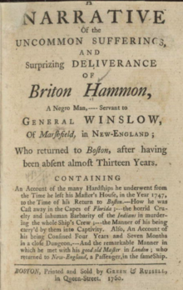
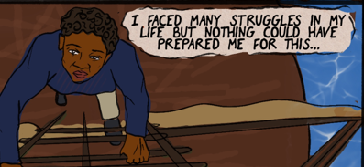
Page 6
Britton Hammon, A Narrative of the Uncommon Sufferings, and Surprizing Deliverance of Briton Hammon, A Negro Man (1760), p.3.
  Hammon was an enslaved man in Massachusetts who recounted his adventures after being shipwrecked, held captive in Cuba, and enlisting in the Royal Navy, being wounded and recovering in Greenwich Hospital, and then reuniting with his ‘owner’ after a spell of poverty and illness in London.
https://docsouth.unc.edu/neh/hammon/hammon.html
“It cannot be expected that I should make those Remarks on the Sufferings I have met with … but shall leave that to the Reader as he goes along …”

Slide 23
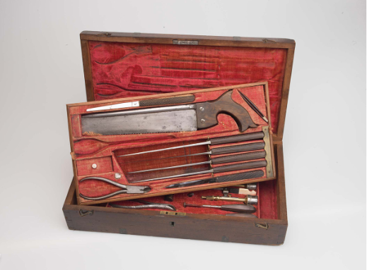
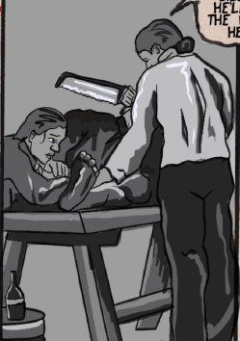
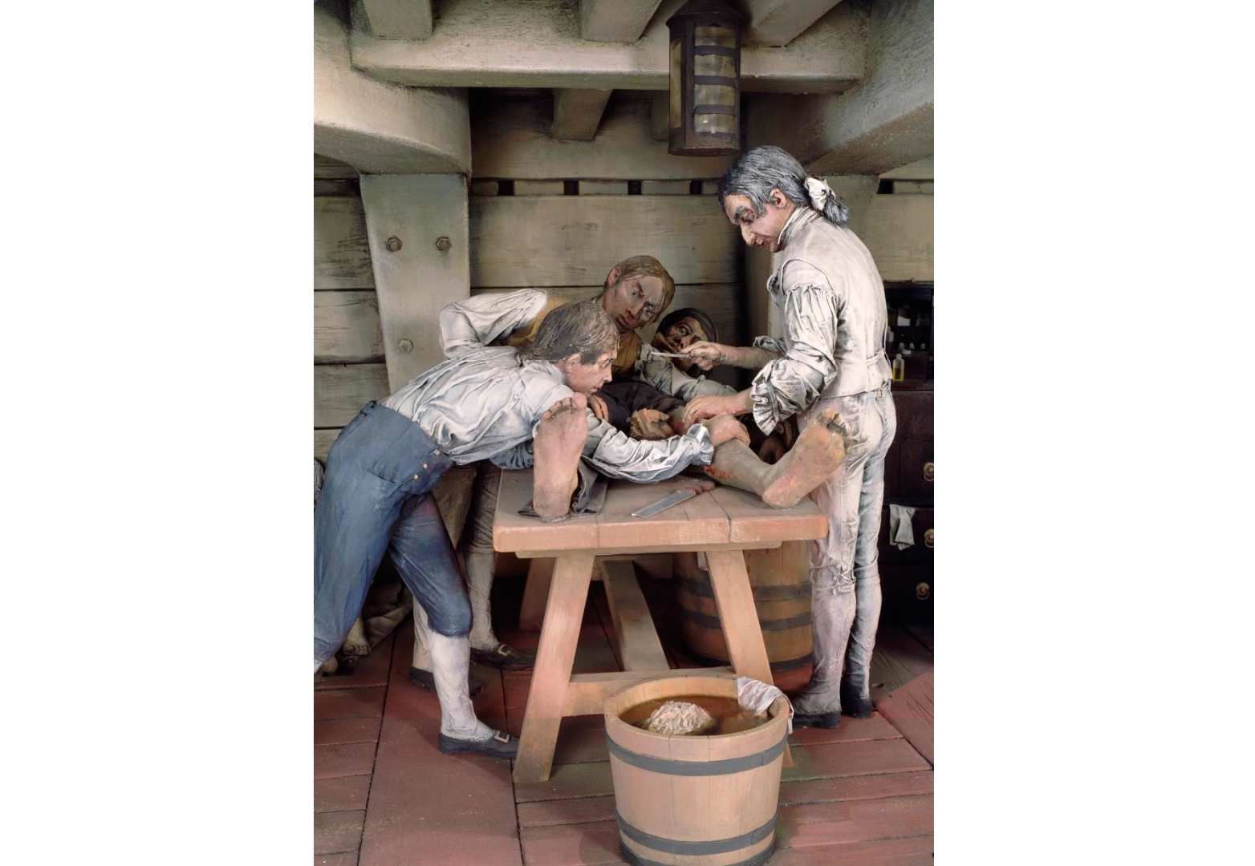
Page 8
Surgical Instrument Set, from Hunterian Museum of the Royal College of Surgeons
https://ageofrevolution.org/200-object/surgical-instrument-set/
Diorama, “Naval Surgery in 1800” in Lower Wellcome Gallery, Science Museum Group
https://collection.sciencemuseumgroup.org.uk/objects/co178382/diorama-showing-naval-surgery-in-the-1800s
“Anaesthetics were not yet in use so sailors had only alcohol for pain relief and a piece of leather to bite on when the pain was at its height.”
Notes:
Richard de Grijs, “The Grim Horrors of the Orlop Deck”, Hektoen International: A Journal of Medical Humanitites (2024): https://hekint.org/2024/01/08/the-grim-horrors-of-the-orlop-deck/.

Slide 24

Page 8
Lyrics of “Johnny I Hardly Knew Ye” (Roud 3137), Irish traditional song, referencing Kandyan Wars (Sri Lanka / Ceylon) c.1795-1818.
https://www.jfklibrary.org/learn/about-jfk/life-of-john-f-kennedy/fast-facts-john-f-kennedy/johnny-i-hardly-knew-ye-irish-folk-song
“Indeed, your dancing days are done!”

Slide 25
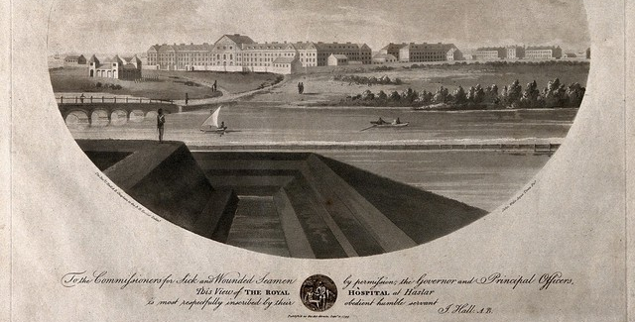

Page 9
Royal Hospital, Haslar, near Portsmouth: view from right. Coloured aquatint with etching by J. Wells, 1799, after J. Hall (Chaplain to the Royal Hospital Haslar)
https://wellcomecollection.org/works/knyq47k5/items
Notes:
Sara Caputo, “Treating, Preventing, Feigning, Concealing: Sickness, Agency and the Medical Culture of the British Naval Seaman at the End of the Long Eighteenth Century, Social History of Medicine 35.3 (2022): 749-769.

Slide 26

Page 9
Admiralty, Instructions for the Royal Naval Hospitals at Haslar and Plymouth (1834), art. 14, p.93.
https://archive.org/details/b28741171
“Those discharged as unserviceable … are to receive their sick-tickets with the discharge certificate … they are to attend at our Office in London, on the first surveying day following their discharge, in order that their claims to be pensioned may be decided upon.”

Slide 27


Page 9
Pay Book of Naval Out Pensions, Greenwich Hospital, Admiralty, ADM22/287/00055, p.57, no. 1214 (listed as Wm Waters / Ganymede / entry 2 June 1817).
https://www.nationalarchives.gov.uk/help-with-your-research/research-guides/royal-navy-ratings-pensions/
Billy Waters would have collected his out-pension of £20 per annum in quarterly lumps of £5 anytime after the 15th of January, April, July and October, from Greenwich.

Slide 28



Page 10
Print by John Thomas Smith in Vagabondia (1817), description p.33.
https://collections.vam.ac.uk/item/O70058/print-smith-john-thomas/
“Black Joe [built] … a model of the ship Nelson … which, when placed on his cap, he can, by a bow of thanks … give the appearance of sea-motion … as frequently to be seen in the rural village as in great cities.”
Anon., “London Ballad Singers” in The Mirror of Literature 6.150 (July 1825), p.42.
https://books.google.co.uk/books?id=vmcJAAAAQAAJ
“But who is there, old or young, among the busy population of Tower-Hill, that does not bear in mind … Joe Johnson!”
Joseph Johnson was a former sailor of Afro-Caribbean origins in the British merchant navy who was discharged without a pension and settled in London, where he became a street entertainer and ballad singer. Some scholars have linked his performance to Jonkonnu.
Image: still featuring Joe Johnson (played by Larrington Walker) from BBC TV series Taboo, by Steven Knight, episode 6, 48m26s.
Notes:
Oskar Cox-Jensen, “Joseph Johnson’s Hat, or, The Storm on Tower Hill,” Studies in Romanticism 58.4 (2019): 545-569.

Slide 29


Page 11
Print of “The Old Adelphi Theatre,” created by ‘WHP’ in 1860 after theatre rebuilt, so showing venue 1819-1858.
https://collections.vam.ac.uk/item/O1388987/adelphi-theatre-print/
The Adelphi Theatre on the Strand, London, was first built as the ‘Sans Pareil’ in 1806. It was renamed in 1819. Performances of the play Tom and Jerry, or Life in London by W.T. Moncrieff, featuring the character Billy Waters, began on 26 November 1821. Cartoon artists the Cruikshank brothers designed the costumes and scenery. Billy was played by a white comic actor, Signor Paulo.

Slide 30

Page 11
James Catnach, The Death, Last Will, and Funeral of Black Billy; also the Tears of London for the Death of Tom and Jerry (c.1823)
  “Every child in London knew [Waters]”
William Reeves, “Lines on Billy Waters” (June 1823)
  “His fiddle caus’d the hearts to bound / Of children as big as me.”

Slide 31


Page 11
‘The Peripatetic no. V’, The Literary Chronicle 20:209 (17 May 1823), p.312
https://archive.org/details/sim_literary-chronicle_1823-05-17_5_209
“One of the merriest of mortals, that ever limped across my peripatetic path … how often have his frolicsome gambols roused me from some melancholy reverie to life and merriment! How often has a single glance at his eccentricities put to flight a whole legion of cares and disquietudes! Even now, he appears to my ‘mind’s eye’, in all his accustomed light-heartedness, gaily dancing, to the tune of his faithful violin … He was truly ‘one in a thousand … none … knew so well how to set the rabble ‘in a roar’ as Billy Waters.”
Notes:
Rodreguez King-Dorset, Black Dance in London, 1730-1850: Innovation, Tradition, and Resistance, (Jefferson, NC: McFarland & Company, Inc., 2008)

Slide 32


Page 12
Charles Hindley, The Life and Times of James Catnach (Late of Seven Dials), Balladmonger (1878), p.135.
https://catalog.hathitrust.org/Record/001160338
“his … efforts to please, excited much mirth and attention, and were well rewarded.”
Douglas Jerrold, “The Ballad Singer” in The Heads of the People (1840), p.297 (excerpt in image).
https://books.google.co.uk/books?id=hDUIAQAAMAAJ
“Who ever danced as he danced? Waters was a genius.”
‘The Peripatetic no. V’, p.312.
“Upon the only leg of flesh and blood, which fate had left him, while he elevates its ligneous associate in a thousand fantastic attitudes, and with a vivacity, which the happiest biped around him might well envy … we ne’er shall look upon his like again.”

Slide 33


Page 12
Charles Hindley, The True History of Tom and Jerry (1858) - image.
https://www.gutenberg.org/files/43504/43504-h/43504-h.htm
  Comment in preface: “One notable effect of “Life in London,” particularly in its dramatised form must be recorded. It broke the heart of poor Billy Waters.”
  Quoting playwright W.T. Moncrieff on pp.104-5: “The fickle British public refused to be as liberal as they had been, which he [Billy Waters] attributed to the production of Tom and Jerry.”
Thomas L. Busby, Costume of the Lower Orders of London (1819), unnumbered.
https://collections.vam.ac.uk/item/O1744942/costume-of-the-lower-orders-book/?carousel-image=2013GN7925
“Remarkable for … the grin of his countenance, and the sudden turn and kick out of his wooden limb.”

Slide 34


Page 13
Thomas L. Busby, Costume of the Lower Orders (1819), unnumbered.
“He supports himself, and those dependent on him, by Fiddling, Dancing, and Singing, through all parts of the metropolis.”
“He has a wife, and, to use his own words, ‘one fine girl, five years old,’ and is not a little proud to perceive a resemblance in the child to himself.”
Rowland Dobie, History of the United Parishes of St. Giles-in-the-Fields (1834), p.264. The master of the school was Thomas Augustin Finnigan.
https://books.google.co.uk/books?id=86lCAAAAYAAJ&lr
“The Irish Free Schools in George Street were established in 1813 … They were founded for the purpose of affording instruction and clothing to the children of the poor Irish Catholics and others, without interfering with their creed. About 200 were thus taken from the streets, where they were exposed to depravity in the extreme.”

Slide 35



Page 13
“Death of Billy Waters” obituary in Morning Advertiser (22 March 1823), p.3.
“[A] peculiar stumping of his wooden leg in an original kind of hornpipe … He was elected King of a party of Beggars in St. Giles.”
Description of ‘The Rose and Crown’ in Henry Mayhew, London Labour and the London Poor (1862), p.300.
https://archive.org/details/cu31924092592793/page/n373/
“In the tap-room might be seen Black Charlie the fiddler, with ten or a dozen lads and lasses enjoying the dance, and singing and smoking over potations of gin-and-water, more or less plentiful according to the proceeds of the previous night - all apparently free from care in their wild carousals.”
Image 1: undated sketch mislabelled “Richard Waters Esq.” attr. to T.L. Busby, National Maritime Museum: https://www.rmg.co.uk/collections/objects/rmgc-object-254870.
Image 2: James Catnach, “Life in London” satirical broadside (1822): https://www.britishmuseum.org/collection/object/P_1997-0223-2.

Slide 36


Page 13
Statement of a beggar quoted in Mayhew, London Labour, vol.1, p.414.
https://www.gutenberg.org/cache/epub/55998/pg55998-images.html
“My grandfather kept the great house, the old Rose and Crown, in Church-lane, opposite Carver-street, best known as the ‘Beggar’s Opera.’ When a child I have seen the place crowded, crammed with nothing but beggars, first-rates – none else used the house. My father took away my mother’s money. I wish my mother had run away instead.”
William Reeves, “Lines on Billy Waters” (June 1823) quoted in Hindley, p.108.
“In vain he fiddl’d, danc’d and sung, / Until he was out of breath; Starving he was, his bow unstrung / Till he danc’d – The Dance of Death.”
Photograph: unnamed pauper holding child on workhouse steps in Short’s Gardens, St. Giles’s, from J. Thomson and Adolphe Smith, “Street Life in London” (1877), which records “What little charity they receive is more frequently derived from the lowest orders.” - https://www.victorianlondon.org/publications/thomson-30.htm
Notes:
The passage continues with a reference to diversity: “I went into a low lodging-house. There was forty men and women sleeping in one room. I had to sleep with a black man, and I slept on the floor to get away from the fellow. There were plenty of girls there; some playing cards and dominoes. It was very dirty – old Mother ----, in Lawrence-lane – the Queen of Hell she was called. There was one tub among the lot of us. I felt altogether disgusted. Those who lived there were beggars, thieves, smashers, coiners, purchasers of begged and stolen goods, and prostitutes.”

Slide 37



Page 14
‘Hatton-Garden’, London Chronicle (21 Feb. 1822), p.5.
https://www.findmypast.com/image-viewer?issue=BL%2F0002634%2F18220222&page=5
  “The officer who apprehended the prisoner informed the Magistrate that the [Mendicity] Society received several complaints from gentlemen of the nuisance caused by his collecting crowds in the streets … and of his singing immodest songs in the hearing of ladies … on his undertaking never to be found begging again he was discharged.”
Bow Street Magistrate, cited in The Times (5 April 1852):
  “one of the most filthy remnants of the old ‘Rookery’ … underlet, nightly or weekly, to the hordes of low Irish who infest the neighbourhood.”
Charles Hindley, The True History of Tom and Jerry, preface.
https://www.gutenberg.org/files/43504/43504-h/43504-h.htm
  “Poor Billy endeavoured, up to the period of his last illness, to obtain for a wife and two children what he termed ‘An honest living by scraping de cat-gut!’”
Notes:
Richard Kirkland, “Reading the Rookery: The Social Meaning of an Irish Slum in Nineteenth-Century London,” New Hibernia Review 16.1 (2012): 16-20.

Slide 38


Page 14
“Death of Billy Waters” obituary in Morning Advertiser (22 March 1823)
“He resided with his family in the house of Mrs Fitzgerald, Church Street, St. Giles’s.”
Trial and testimony of Catherine Hannagan in Proceedings of the Old Bailey, no.18110918-179, September 1811.
https://www.oldbaileyonline.org/record/18110918
“Coming along the road I met with this woman, she said if I was to go to St. Giles’s I might find some of my country people who would give me a lodging.”
Mary Shannon, Billy Waters is Dancing (2024), p.137.
  “The Fitzgeralds … seem to have controlled quite a bit of the Rookery from around 1810 onwards … No doubt when the parish rates collectors came around, the Fitzgeralds and other landlords were ready, shifting tenants from one house to another.”
Final entry under William Waters, ‘A Black Man’ described as ‘D.D.’ (discharged, dead) in Pay Book of Naval Out Pensions, Greenwich Hospital, Admiralty, ADM22/332 (entry 21 April 1823):
  £5 “to widow Elizabeth”

Slide 39



Page 14
Response from Letter V (1769), Ignatius Sancho, Letters of the Late Ignatius Sancho, An African. In Two Volumes (1782), vol.1, p.18.
  Sancho (c.1729-1780) was a British abolitionist, writer and composer, born on a slave ship in the Atlantic and spending years in service in Greenwich before becoming independent and voting (the first known British African to do so) in general elections.
https://docsouth.unc.edu/neh/sancho1/sancho1.html
“Poor Pat has paid his last debt – peace and bliss to his spirit! Rest to his bones!”
Charles Hindley, True History of Tom and Jerry, p.103:
  “The burden of Billy’s ditty … was: - / Polly will you marry me – Polly don’t you cry, / Polly will you marry me – Polly don’t you cry.”
Tony Montague, “‘An o-o-old song’: Billy Waters, the African American musician who captivated 1820s London” in The Guardian, 21 March 2023
  “Sadly Waters left no music – just one bluesy couplet, with variants, from his signature song: ‘Polly will you marry me? Polly don’t you cry, / Polly come to bed with me and get a little boy.’”
Notes:
Polly and Kitty were both common names for a sailor’s girl in eighteenth-century folk music and popular culture (akin to Jack Tar for a sailor).

Slide 40


Page 15
John Cary, Cary’s New and Accurate Plan of London and Westminster…with the reference to the Situation and Plans of the New London & East & West India Docks (1820).
https://mapco.net/london.htm

Slide 41


Page 15
George Scharf, “Men and boys with advertising boards,” sketched from his coach, c.1825.
https://www.britishmuseum.org/collection/object/P_1862-0614-1187
  Shows the breadth of migration and power of advertising and the competition for attention on the streets, including figures and events glorifying the British empire and military. Advertised are Irish singers, masquerades, military dioramas, pens, whisky, exhibitions and accommodation – while locations include Piccadilly, Regent’s Park, Pall Mall, Cavendish Street, Oxford Street.

Slide 42




Page 15
“Rabbit-Man” and “Fish woman” in plates of Thomas L. Busby, Costume of the Lower Orders of London (1820)
https://digitalcollections.nypl.org/collections/costume-of-the-lower-orders-of-london#
John Wykeham Archer, Part of the Rookery, St. Giles (1844), watercolour over graphite sketch, The British Museum.
https://www.britishmuseum.org/collection/object/P_1874-0314-113

Slide 43


Page 15
Engraving by Benjamin Cole, Print of Bridewell Palace, Prison, London (1756), hand-coloured.
https://www.classicalimages.com/products/1756-maitland-large-antique-print-of-bridewell-palace-prison-london-england

Slide 44




Page 15
Photo: Three lascars of the ‘Viceroy of India’ (1829), Waterline Collection, National Maritime Museum.
https://www.ourmigrationstory.org.uk/oms/the-lascars-britains-colonial-era-sailors
Detail from George Cooke painting Commercial Docks at Rotherhithe (1827), National Maritime Museum.
https://images.rmg.co.uk/asset/2302/

Slide 45



Page 15
Anon., “Two Chelsea Pensioners arm-in-arm, one, with a wooden leg…”, colour lithograph (date unknown)
https://wellcomecollection.org/works/cqkmk84x/images?id=j9452ebv
Detail from David Wilkie, The Chelsea Pensioners reading the Waterloo Dispatch (1822) – commissioned by Duke of Wellington in 1816.
https://en.wikipedia.org/wiki/Chelsea_Pensioners_reading_the_Waterloo_Dispatch#/media/File:David_Wilkie_Chelsea_Pensioners_Reading_the_Waterloo_Dispatch.jpg
Notes:
Image features in Peter White, Disability: A New History, BBC 4 Radio series: https://www.bbc.co.uk/programmes/b021mdwt.

