Slide 1
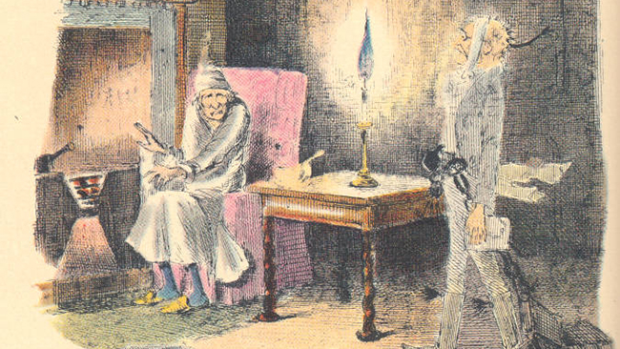
Introduction to London in Stave 1, The Christmas Carol
And Billy Waters
Notes:
Aims and Objectives: to introduce a vision of London as polluted and with a sharp class division. Key words: social inequality. Marginalisation. By the end of the session the students will have analysed a passage from Stave 1, and identified patterns within the extract of light, dark, warmth and cold, making links between the lot of the different strata in London society. They will also explore and contribute to a discussion on diversity in London life of the time. They will discuss reasons why some were marginalised in Victorian London. A lesson to be used early in the teaching of A Christmas Carol.

Slide 2
Read this passage from The Christmas Carol
Meanwhile the fog and darkness thickened so, that people ran about with flaring links, proffering their services to go before horses in carriages, and conduct them on their way. The ancient tower of a church, whose gruff old bell was always peeping slily down at Scrooge out of a Gothic window in the wall, became invisible, and struck the hours and quarters in the clouds, with tremulous vibrations afterwards as if its teeth were chattering in its frozen head up there. The cold became intense. In the main street, at the corner of the court, some labourers were repairing the gas-pipes, and had lighted a great fire in a brazier, round which a party of ragged men and boys were gathered: warming their hands and winking their eyes before the blaze in rapture. The water-plug being left in solitude, its overflowings sullenly congealed, and turned to misanthropic ice. The brightness of the shops where holly sprigs and berries crackled in the lamp heat of the windows, made pale faces ruddy as they passed. Poulterers’ and grocers’ trades became a splendid joke: a glorious pageant, with which it was next to impossible to believe that such dull principles as bargain and sale had anything to do. The Lord Mayor, in the stronghold of the mighty Mansion House, gave orders to his fifty cooks and butlers to keep Christmas as a Lord Mayor’s household should; and even the little tailor, whom he had fined five shillings on the previous Monday for being drunk and bloodthirsty in the streets, stirred up to-morrow’s pudding in his garret, while his lean wife and the baby sallied out to buy the beef.
Notes:
Read with the students. Ask students to open the text at this page.

Slide 3
What words didn’t you understand? Write them into your text ….
Flaring links - torches often made of wax, used to light the streets.
Proffering – to offer or put forward
Tremulous - shaking
Brazier - a mobile heater that uses lighted coals to warm people.
Water-plug – a fire hydrant, (here it has frozen up).
Poulterers – a butcher’s shop that only sells chicken, turkey, duck etc.
Pageant - a public entertainment, often with performance and costumes.
Stronghold – a place that has been protected against attack
Mansion House – the name of the house where the Lord Mayor of London lived
Garret – a top-floor or attic room
Sallied out – to leave a place, often energetically
Notes:
Ask for suggestions, before revealing the ones that are listed here. Encourage students to annotate their text.

Slide 4
Two teams: Team One: collect all the words in the extract to do with “things”. Team Two: collect all the words to do with “people”
To start you off:
THINGS – fog, darkness, flaring links, horses
PEOPLE – people, Scrooge, labourers
See how many you can collect in three minutes.
https://www.youtube.com/watch?v=iHdviZkM7S4
Notes:
Divide the class into two. Use a three minute timer. Whichever team has the most, wins.

Slide 5
How many did you get?
THINGS | PEOPLE
fog darkness flaring links Horses Carriages tower of a church Bell Gothic window in the wall Clouds main street Court gas-pipes great fire in a brazier Blaze water-plug Ice Shops holly sprigs and berries lamp heat of the windows Poulterers’ and grocers’ trades Pageant streets Garret beef | People Scrooge Labourers ragged men and boys The Lord Mayor cooks and butlers little tailor Lean wife Baby
Notes:
Ask for suggestions before revealing … discuss ones that they might have missed, and why they might have missed them.

Slide 6
In your groups, discuss what you notice about the patterns and contrasts here. What links can you see between the colours?
fog
darkness
flaring links
Horses
Carriages
tower of a church
Bell
Gothic window in the wall
Clouds
main street
Court
gas-pipes
great fire in a brazier
Blaze
water-plug
Ice
Shops
holly sprigs and berries
lamp heat of the windows
Poulterers’ and grocers’ trades
Pageant
streets
Garret
Beef
Can you see any other patterns here?
Why do you think Dickens includes these contrasts?
Notes:
In groups of four, then discuss as a class. Light v dark. Warmth v cold etc – and why….

Slide 7
What about with the characters?
People
Scrooge
Labourers
ragged men and boys
The Lord Mayor
cooks and butlers
little tailor
Lean wife
Baby
Notes:
Characters with money and/or status; characters who work for their living; characters who have no money (or status)

Slide 8
What sort of a London does Dickens portray here?
You might think about:
Imagery of light and dark
Imagery of warmth and cold
Characters who have no money
Characters who work for their money
Characters who are rich, and protected
A London that was polluted by the smoke of the factories.
A London with a sharp division between the rich and the poor.
The poor are in the foggy street, in the cold and dark, huddling around a fire. The Lord Mayor is inside his house, giving orders to his employees.
Notes:
Allow students to respond to the prompts, before revealing the final three points here.

Slide 9
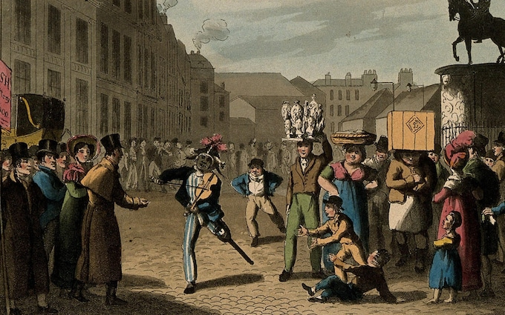
Discussion:
What sort of a London do you see here?
Can you identify the same characters that you saw in the extract from A Christmas Carol? (Gentlemen and ladies, ragged men and boys, labourers, street sellers etc)
Who is the character in the centre? Why do you think he wearing that costume?
Notes:
Class discussion

Slide 10
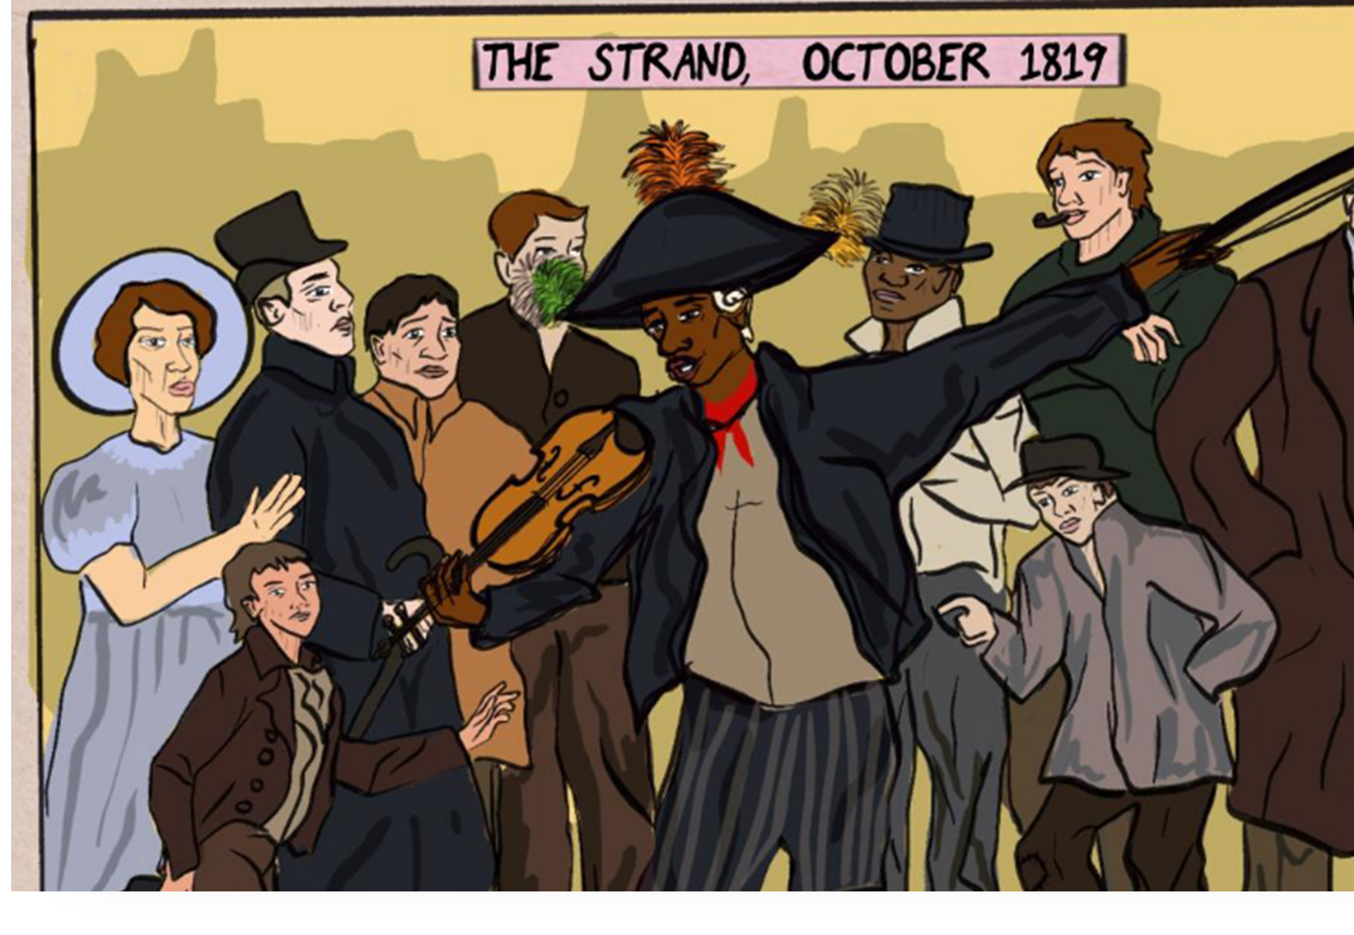
The Central Character is Billy Waters
Billy Waters was born in the 1770s in New York. When he grew up, he became a Royal Navy sailor, and lost a leg in an accident. He became one of London’s most famous street performers of the time.
Notes:
Explanation and link to graphic novel

Slide 11
Everybody knew about Billy Waters because he got turned into a character in a hit play that was put on in London, America and Dublin, Ireland.
“It ends up as quite a sad story because even though the producers of the play made an awful lot of money out of the play […] Waters didn’t make any money at all. In fact, the story goes that because he was being represented not in a positive light I should say, but as somebody who was faking being deserving of charity […] somebody who was laughing at people who gave him money - because he was represented in this way, the story goes, people stopped helping him out, giving him money in real life […] The real, horrible irony is that in order to get into the Adelphi Theatre in The Strand [where the play was on], the audience had to walk past actual Billy Waters doing his actual performance outside the theatre. So they had to ignore him and go in and watch the stage character. (Dr Mary L Shannon, Roehampton Talks)
https://www.youtube.com/watch?v=EQwbb2HA640
Notes:
Read extract from Dr Shannon’s talk.

Slide 12
What similarities do you notice between the London in A Christmas Carol and the London represented in the talk about Billy Waters?
Both show poor characters shut out from places (from shops in A Christmas Carol, and from the theatre in Dr Shannon’s talk).
Both show a lack of concern from the rich (the Lord Mayor, and Scrooge in A Christmas Carol, and the theatre goers in Dr Shannon’s talk).
Both show the rich benefitting from the poor (the people who light the way for the carriages, the labourers, the cooks and butlers in A Christmas Carol, and the theatre producers in Dr Shannon’s talk).
This is a London where the class divide is clear.
Notes:
Pair work, and then whole class discussion.

Slide 13
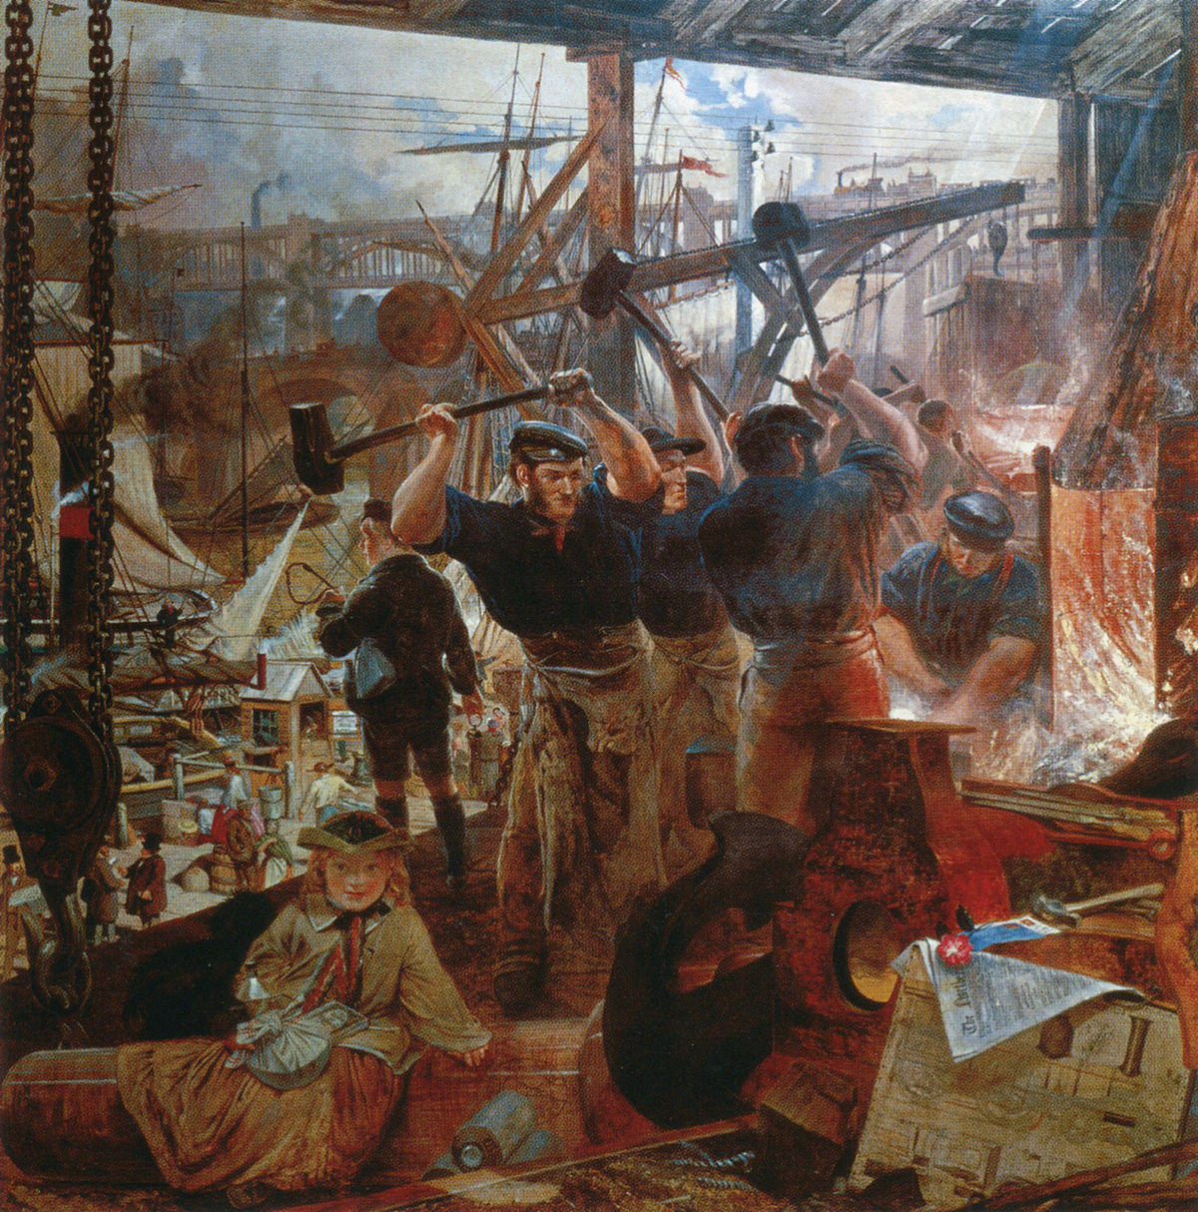
Your Assignment: find out ten facts about the Industrial Revolution.
You might start by thinking about when it happened.
How did it affect London?
How did it affect the population, for example?
How did it affect the division between the classes?
How did it affect the pollution?
This Photo by Unknown Author is licensed under CC BY-SA

Slide 14
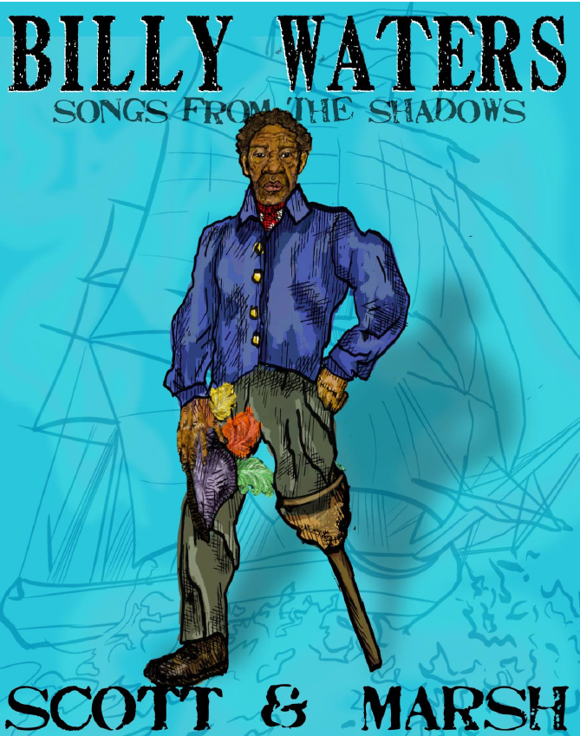
For further information about Billy Waters, and free teaching resources see:
https://ageofrevolution.org/home/billy-waters/

